Slide 1
Logistic Regression

Slide 2
Logistic Regression
It is used when the data is linearly separable and the outcome is binary.
That means Logistic regression is usually used for Binary classification problems.
Ex. Yes/No, Pass/Fail, Win/Lose, Cancerous/Non-cancerous, etc.
Types of Logistic Regression
Simple Logistic Regression: a single independent is used to predict the output
Multiple logistic regression: multiple independent variables are used to predict the output

Slide 3
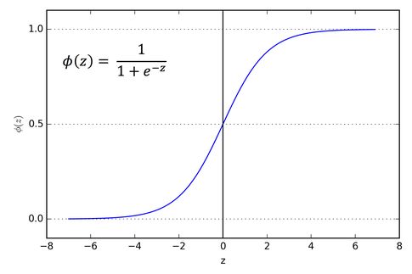
Sigmoid Curve

Slide 4
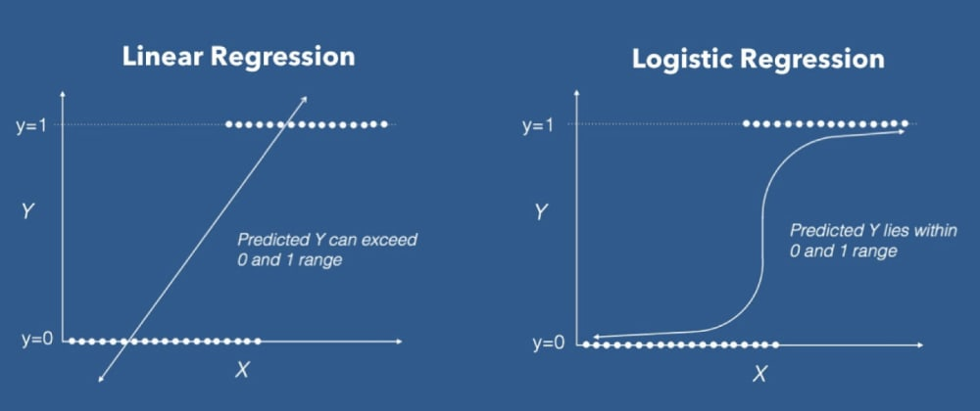
Linear Vs Logistic Regression

Slide 5
Logistic Regression
Buidling Model
from sklearn.linear_model import LogisticRegression
clf = LogisticRegression() # training the model
clf.fit(X_train, y_train)
Predicting the output
y_pred = clf.predict(X_test)
#Finding Accuracy
from sklearn.metrics import accuracy_score
accuracy = accuracy_score(y_test, y_pred)
print("Accuracy: {:.2f}%".format(accuracy * 100))

